Slide 1
Physics

Slide 2

Notes:
So, physics – I should warn you now that this series of slides is really about convincing you to go away and find a third party library to do anything more complex than the basics of velocity & acceleration. There are entire books devoted to physics for games, so we’re just going to be skimming the surface of the topic.
Having said that – let’s crack on. Most modern games have systems in place that are in place to stop solid objects moving through each other, the core of that system is the collision detection system. Collision systems are often integrated with the physics engine; which is not to say that it’s modelling the subatomic interactions of an object, instead, we’re interested in modelling the rigid body dynamics between objects.

Slide 3

Notes:
Let’s go over some definitions quickly:
Rigid bodies are an idealized representation of an infinitely hard, non-deformable solid object.
Dynamics are the process of determining how rigid bodies move and interact over time under the influence of forces.
Forces are pushes or pulls. They are measured in newtons. Unbalanced forces change the way something is moving.
A newton is defined as the force required to accelerate a mass of one kilogram at a rate of one meter per second squared.
Acceleration is not a force, gravity is a force – when gravity is applied to an object, it causes acceleration.

Slide 4


$$F=\sum_{x=0}^{n}{f_{x}}$$
void ApplyForces()
{
Vector3 currentForce = Vector3(0.0f, 0.0f, 0.0f);
currentForce = AccumulateForces(forces, 5);
VecList::iterator it;
for (it = impulses.begin(); it != impulses.end(); it++)
{
currentForce += *it;
}
impulses.clear();
}
Vector3 AccumulateForces(const Vector3 *forces, int size)
{
Vector3 Force = Vector3(0.0f, 0.0f, 0.0f);
for (int i = 0; i < size; i++)
{
Force += forces[i];
}
return Force;
}
Notes:
So let’s look at how we use a force to move an object in our world (these calculations work in both 2D and 3D space with no change other than the sort of vector we use to store our values).
Applying a constant force is nice and straightforward, we just accumulate all of the constant forces together:
A constant force over time equates to some acceleration over time, depending on mass. An impulse on the other hand is instantaneous, so it only affects the acceleration once – a rocket motor is a constant force, hitting something with a baseball bat is an impulse.
We can model that using something like the following:
Notice how we clear our list of impulses at the end of the function – they only apply for a single frame, so we don’t want to keep them around once we’ve applied them.

Slide 5



$$a=\frac{F}{m}$$
$$F=m∗a$$
accel = F / mass;
vel += accel * time;
pos += vel * time;
Notes:
Once we have our forces, we can make use of them – and this is where the old force = mass * acceleration equation comes in.
Well, a derivative of it anyhow – given that we have our force already, we can rework that equation to allow us to calculate the acceleration:
Which we can then use to alter our velocity and thus, our position:
We need to be a bit careful with our time value, all of our movement relies upon it and if we use a value that’s too big or too small, we might get some odd behaviours and unexpected results in return – so if you do implement your own physics system and things seem out of whack, start by checking you time values!

Slide 6
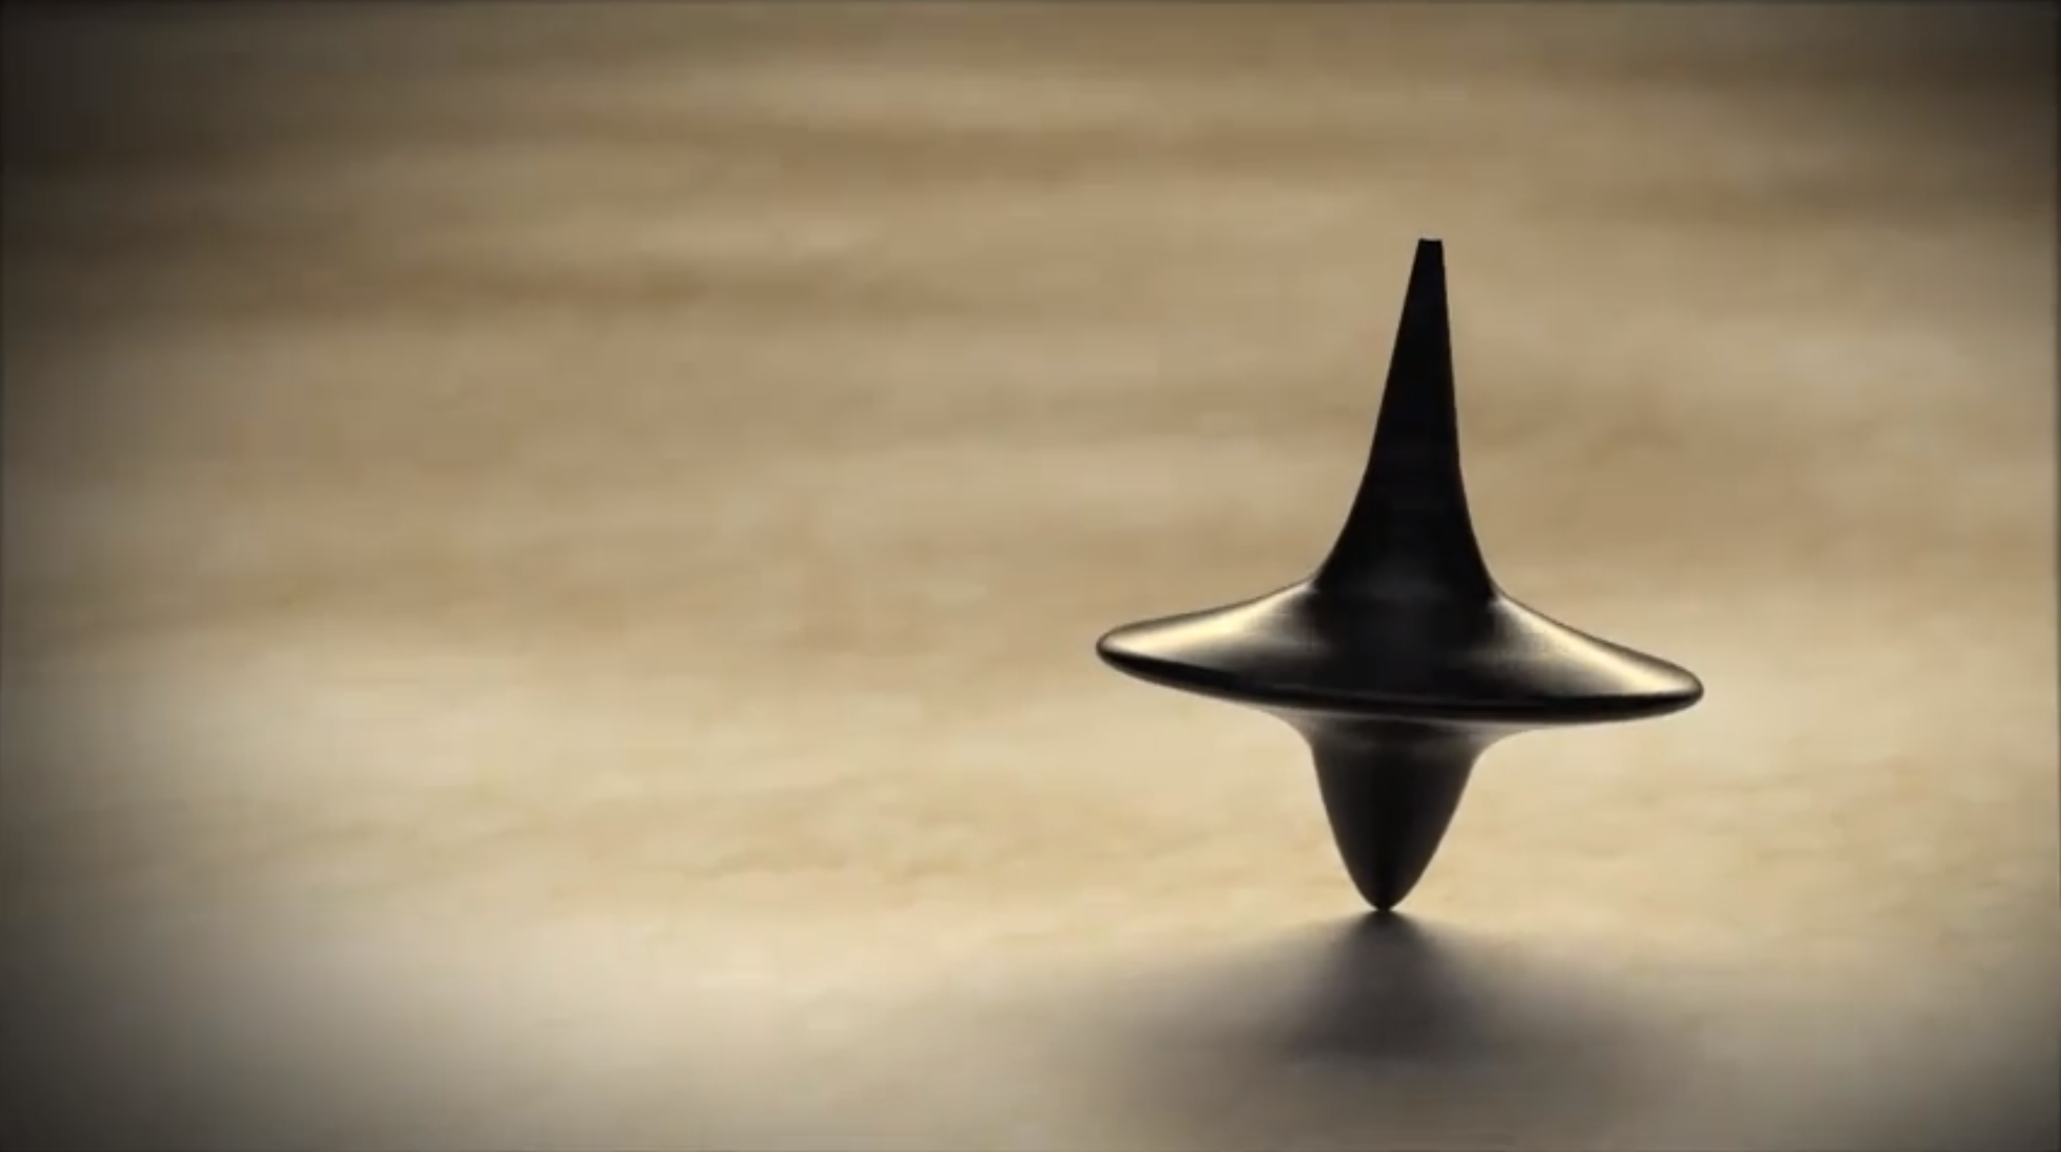
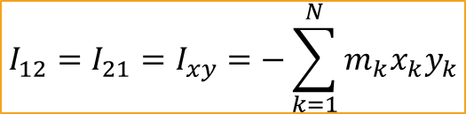
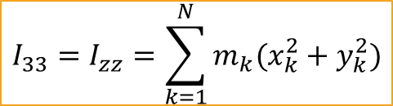
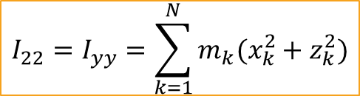
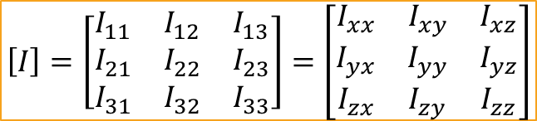
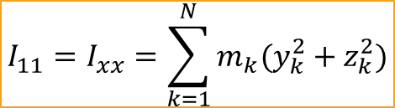
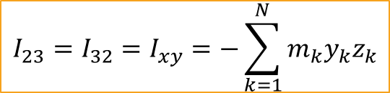
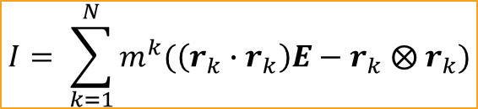
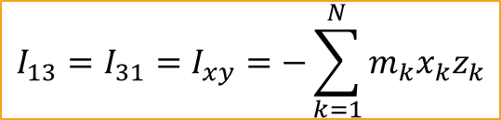
$$I= \sum_{k=1}^{N}{m^{k}(\left(r_{k}∙r_{k}\right)E−r_{k} ⨂{ r}_{k})}$$
$$I_{11}=I_{xx}=\sum_{k=1}^{N}{m_{k}(y_{k}^{2}+z_{k}^{2})}$$
$$I_{12}=I_{21}=I_{xy}=−\sum_{k=1}^{N}{m_{k}x_{k}y_{k}}$$
$$I_{22}=I_{yy}=\sum_{k=1}^{N}{m_{k}(x_{k}^{2}+z_{k}^{2})}$$
$$I_{13}=I_{31}=I_{xy}=−\sum_{k=1}^{N}{m_{k}x_{k}z_{k}}$$
$$I_{33}=I_{zz}=\sum_{k=1}^{N}{m_{k}(x_{k}^{2}+y_{k}^{2})}$$
$$I_{23}=I_{32}=I_{xy}=−\sum_{k=1}^{N}{m_{k}y_{k}z_{k}}$$
$$\left[I\right]=\left[\begin{matrix}I_{11} & I_{12} & I_{13} \\ I_{21} & I_{22} & I_{23} \\ I_{31} & I_{32} & I_{33}\end{matrix}\right]=\left[\begin{matrix}I_{xx} & I_{xy} & I_{xz} \\ I_{yx} & I_{yy} & I_{yz} \\ I_{zx} & I_{zy} & I_{zz}\end{matrix}\right]$$
Notes:
When we move an object through space, whenever we reference it’s position, we’re in fact referring to the objects center of mass – we know about how that works almost intuitively, but there are some things to be aware of about how it impacts the movement of an object. An object that is allowed to rotate freely will always rotate around its center of mass, how easy it is to make an object rotate depends on their shape and how their weight is distributed around the volume of the shape. (A Frisbee spins easily when thrown correctly, but try throwing it so it flips end over end and it won’t last long). This property is known as the inertia tensor.
We can make use of the inertia tensor in our code, though it’s quite expensive to calculate, so we generally only want to calculate it at load or offline for some shapes. We can store it as a 3x3 matrix that describes how difficult it is to rotate an object around any possible axis. We have to take into consideration an objects shape, density and mass to compute the matrix. In effect, it’s a property of the object that will affect how the object rotates – it is to orientation as mass is to position. The process of calculating the inertia tensor is a bit scary:

Slide 7
$$I= \sum_{k=1}^{N}{m^{k}(\left(r_{k}∙r_{k}\right)E−r_{k} ⨂{ r}_{k})}$$
$$I_{11}=I_{xx}=\sum_{k=1}^{N}{m_{k}(y_{k}^{2}+z_{k}^{2})}$$
$$I_{12}=I_{21}=I_{xy}=−\sum_{k=1}^{N}{m_{k}x_{k}y_{k}}$$
$$I_{22}=I_{yy}=\sum_{k=1}^{N}{m_{k}(x_{k}^{2}+z_{k}^{2})}$$
$$I_{13}=I_{31}=I_{xy}=−\sum_{k=1}^{N}{m_{k}x_{k}z_{k}}$$
$$I_{33}=I_{zz}=\sum_{k=1}^{N}{m_{k}(x_{k}^{2}+y_{k}^{2})}$$
$$I_{23}=I_{32}=I_{xy}=−\sum_{k=1}^{N}{m_{k}y_{k}z_{k}}$$
$$\left[I\right]=\left[\begin{matrix}I_{11} & I_{12} & I_{13} \\ I_{21} & I_{22} & I_{23} \\ I_{31} & I_{32} & I_{33}\end{matrix}\right]=\left[\begin{matrix}I_{xx} & I_{xy} & I_{xz} \\ I_{yx} & I_{yy} & I_{yz} \\ I_{zx} & I_{zy} & I_{zz}\end{matrix}\right]$$
Notes:
To start the rotation of a body, we increase its angular velocity, which is a property of physics objects that describes the axis of spin and the speed of rotation at the same time in a single 3D vector. The magnitude of the vector is the spin in units per second while the direction of the vector shows the rotational axis.
Angular force meanwhile is also known as torque and is measured by a force applied about a spin radius – consider using a wrench to undo a bolt, you are applying torque to the bolt using the wrench as a lever. Torque is measured by force, specified in Newton-meters in metric or foot-pounds for imperial (engines are often said to be able to generate x foot pounds of torque, which is the amount of work done to rotate the crank shaft (basically)).

Slide 8

Ray
Triangle
bool AABBIntersection(const Rect &rectA, const Rect &rectB)
{
if (rectA.x < rectB.x + rectB.width &&
rectA.x + rectA.width > rectB.x &&
rectA.y < rectB.y + rectB.height &&
rectA.height + rectA.y > rectB.y)
{
return true;
}
else
{
return false;
}
}
bool CircleIntersection(const Circle &circleA, const Circle &circleB)
{
float dx = circleA.x - circleB.x;
float dy = circleA.y - circleB.y;
float distance = sqrt(dx * dx + dy * dy);
if (distance < circleA.radius + circleB.radius)
return true;
else
return false;
}
Plane
Axis-Aligned Bounding Box
Sphere
Oriented Bounding Box
Cylinder
Frustum
Cone
Convex Polyhedron
www.realtimerendering.com/intersections.html
Notes:
Now that we can move and rotate an object, we can start to care about what happens if two objects intersect with each other; and it’s here that we really do start to realise that we don’t want to be writing this code ourselves. There are a large number of different types of objects we may want to do intersection tests against:
In a 2D game, we might be able to get away with a couple of pretty straightforward intersection checks; AABB and circle (so, AABB against AABB and circle against circle)
For anything more complicated – take a look at the resources provided by the authors of real-time rendering.

Slide 9

Link physics data to game objects
Optimize collisions for static objects
Notes:
Now, we’ll talk about physics engines… Ideally, any physics engine you look at should have a reasonable subset (if not all) of these features:
As the physics system simulates the movements of physical objects in the game, it needs some way to associate the physics objects in its system with actual objects in the game. Especially as the physics representation of an object can be really quite abstract in comparison to the game representation.
Static objects are, in most physics systems, those with a mass of 0 – which is used to flag them as unmovable. A good physics system will make use of static actors to speed up dynamic calculations.

Slide 10
Link physics data to game objects
Optimize collisions for static objects
Generate and report collision events
Provide a fast raycaster
Visual debugger
Notes:
Beyond moving objects around, we also want to be able to get information about the times those object hit each other and beyond that, we want to know as much about that collision as possible; the force of the collision, the normal of it and the two objects that collided (at a minimum really).
A raycaster is something that returns one or more objects that intersects with a given ray (sometimes known as a probe ray), think firing a gun or doing a vision check for an AI. A step up from this is a shapecast, where we cast a specific shape along a ray and check for intersections.
Most physics SDKs offer some way for them to send debug information into a rendering pipeline – which means we can visualise things like collision shapes, force vectors and contact points.

Slide 11
Link physics data to game objects
Error outputs
Optimize collisions for static objects
Allow custom memory allocators
Generate and report collision events
Dynamic addition / removal of objects from simulation
Provide a fast raycaster
Visual debugger
Notes:
For most stable systems, the majority of physics errors come from bad data or misuse of the API – so what we want is for our physics SDK to have a way to report errors to use directly, either through a logging system or by injecting them into a debugging information window.
As we’ve discussed, memory allocations are important things to consider – so we want our physics SDK to appreciate that and either do no / minimal allocations (which is pretty unlikely) or let us tell is about our custom memory allocators.
Physics calculations are pretty expensive, so we want to be able to minimise the impact on our system by ensuring we only do those calculations for objects that are visible to the player (or, if not visible, at least close by). So a good physics SDK will allow us to group together objects and toggle them on and off at will.

Slide 12
Link physics data to game objects
Error outputs
Optimize collisions for static objects
Allow custom memory allocators
Generate and report collision events
Dynamic addition / removal of objects from simulation
Provide a fast raycaster
Save and load its own state
Visual debugger
Notes:
A physics system should be able to stream its data so that it can save or load its state, this is useful for both saving state of objects in the game world but also through the editor – so we can allow the physics system to stabilise objects as they are placed in the editor and then save the final state of the object.

Slide 13
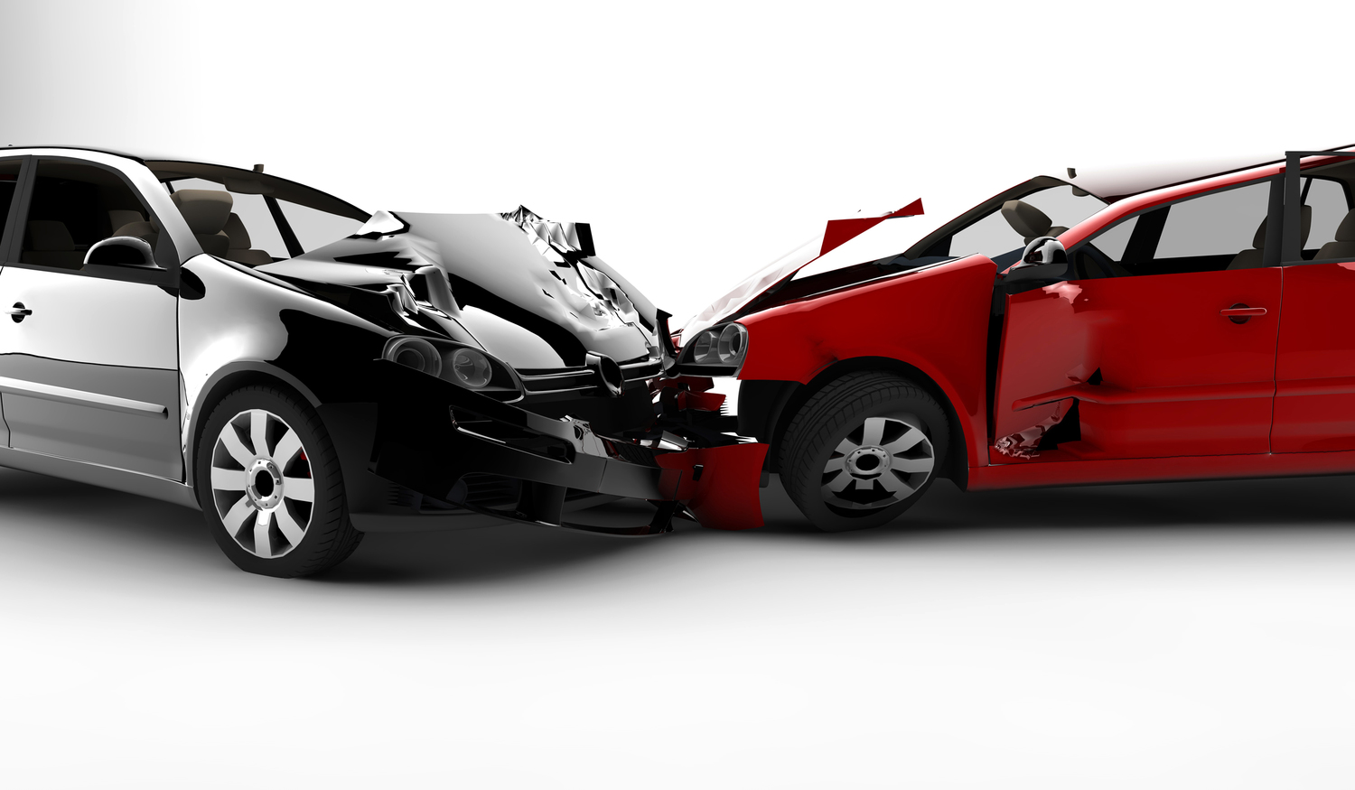
ODE
http://www.ode.org
Bullet
http://www.bulletphysics.com
Notes:
So here are a few physics SDKs that you could integrate with your engine:
ODE (Open Dynamics Engine) is an open source collision and rigid body dynamics SDK, it has a good range of features (equivalent to many commercial solutions) but you also get full source code access, so tracking down bugs and issues is easier.
Bullet is another open source library that is used by both the film game and film industries. While its collision engine is integrated with its dynamics simulation, there are methods built in that mean you can use the collision stand-alone or integrated with other physics libraries. Bullet was developed to work really well with small, fast-moving objects (like bullets…)

Slide 14
ODE
http://www.ode.org
Bullet
http://www.bulletphysics.com
PhysX
https://developer.nvidia.com/physx-sdk
Box2D
http://box2d.org/
Newton Game Dynamics
http://newtondynamics.com/
Notes:
PhysX started life as a library built around hardware physics coprocessors. Since it was bought by Nvidia it has been retooled to use their GPUs rather than separate hardware, though it can be run entirely on the CPU. It is completely free to use and is the physics engine behind Unreal 4 and Unity.
Box2D is the only 2D specific library on the list, it offers constrained rigid body simulation and collision detection and response. It is written in C++ but has been ported to a number of other languages. It is used for all 2D physics in Unity.
Newton Game Dynamics (or just Newton Dynamics) is a cross platform physics simulation library that is focussed on being life-like. It is open source, with all code available on Github, it has seen some use in indie games such as Amnesia, Mount & Blade and the Penumbra series.

